Slide 1

Waste
Roman Kluvanec
Dalibor Adamec
Števo Krajanec
Filip Hajnovič

Slide 2

Separating waste
Waste is separated in trash cans
There are three types of separating trash cans:
  Yellow – for plastics
  Blue – for paper
  Green – for glass
It‘s important to separate waste because it will be recycled and it‘s ecological.
There aren‘t many separating trash cans in Nitra

Slide 3
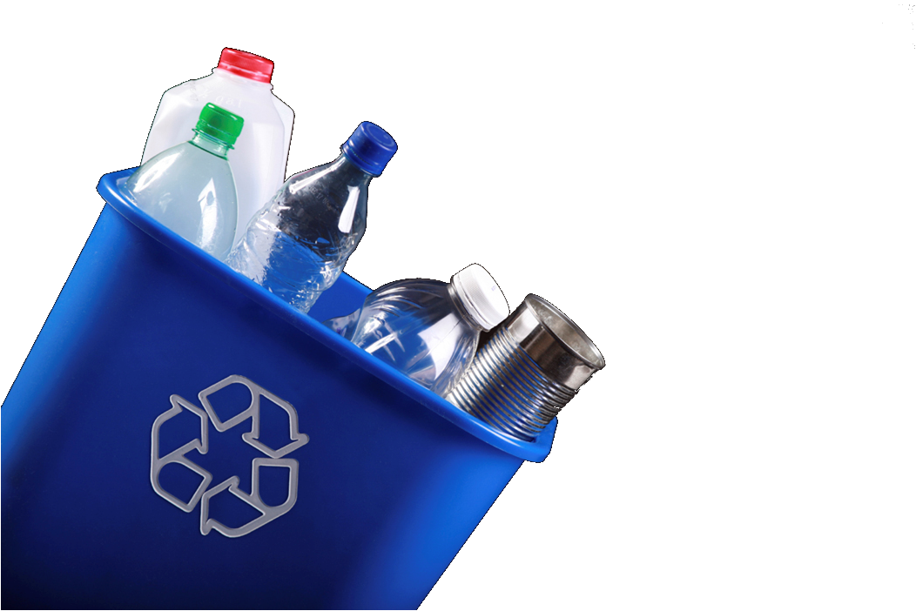
Plastics
Plastics are separated in yellow trash cans
In those cans, you should throw only plastic bottles, containers, cups, wrappings.....
Plastic bottles are then recycled and then changed to new bottles

Slide 4
Paper
Paper is separated in blue trash cans
You shouldn‘t throw there Tetrapak cans from milk and plastic papers
Paper is then recycled to newspapers and toilet paper

Slide 5

Glass
Glass is separated in green trash cans
You shouldn‘t throw plastic bottles into it.
Glass is recycled to new bottles then.

Slide 6

Technical waste
Technical waste is separated in special trash cans.
Our school has also this kind of trash can.
You collect points by putting things into it.
It will be destroyed more ecologically

Slide 7


Slide 8

Classic waste
Our school has trash cans for classic waste.
They‘re red and big.

Slide 10
Building waste
Our school is now in reconstruction.
Builders now throw waste at the back of our school
It‘s not ecological but this big anmount of waste can‘t be put to trash can.

Slide 12
Katruša
There is a dump near Nitra
It‘s called Katruša
Building waste is put there.
Katruša is paid by city

Slide 14
Pollution of the river Nitra
Our river is really polluted
It‘s the most polluted river in central Europe
We need to take care of the river
It‘s so polluted because factories are putting waste in it

Slide 16
Cafilery
There was a cafilery in Nitra
It was closed last year because it was polluting the air and water
We are happy that it was closed because a lot of people didn‘t like it.

Slide 18
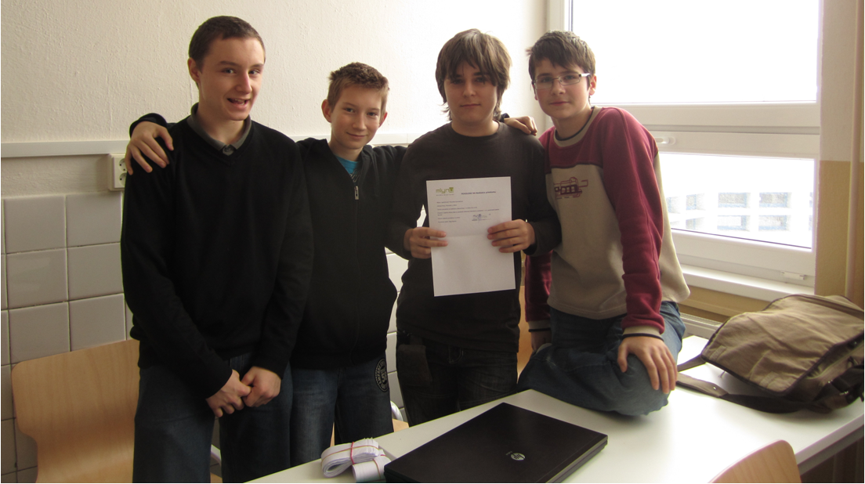
Questionnaire
We made a questionnaire about waste in Nitra
It included about 160 pieces
We even got a permission to make it in the shopping centre Mlyny. You can see it on this picture

Slide 24
Summary
We hope that waste situation in Nitra will improve in short time
Cafilery was closed because it was dangerous
We hope that city will try to make good life for people

