Slide 1
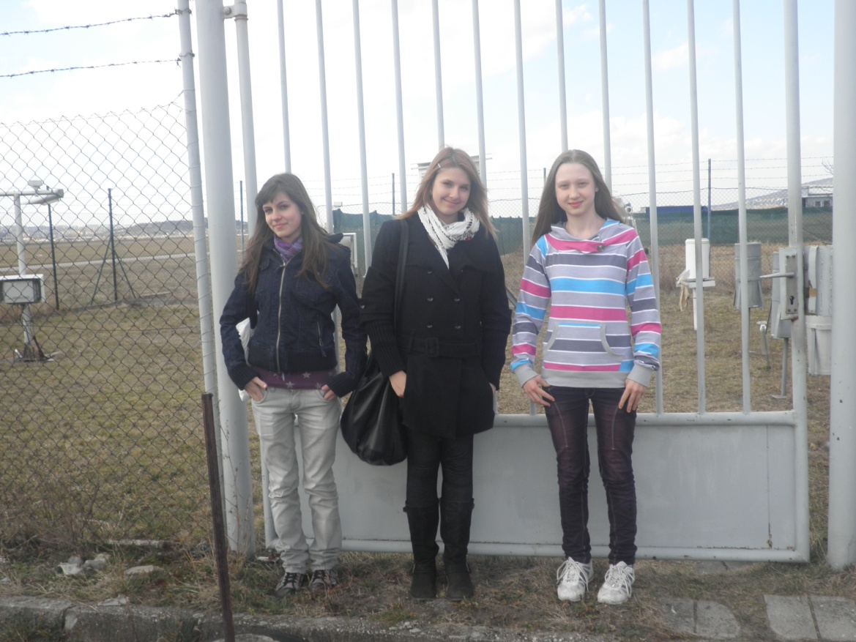
WEATHER
Veronika Halvelandová
Barborka Hladká
Zuzka Kmeťová
Notes:
Meteorologicky ustav fotos, a info, z knižky priemerne hodnoty

Slide 2
Research questions
What is the climate in Nitra region?
How did people make weather forecast in the past?
What were the temperature records?
How are the professional measurements done at meteorological station?
What are the problems caused by the weather?

Slide 3
Definitions
Climate is the term for the average atmospheric conditions over longer periods of time.
Weather is the state of the atmosphere, to the degree that it is hot or cold, wet or dry, calm or stormy, clear or cloudy. Weather refers, generally, to day-to-day temperature and precipitation activity, whereas

Slide 4
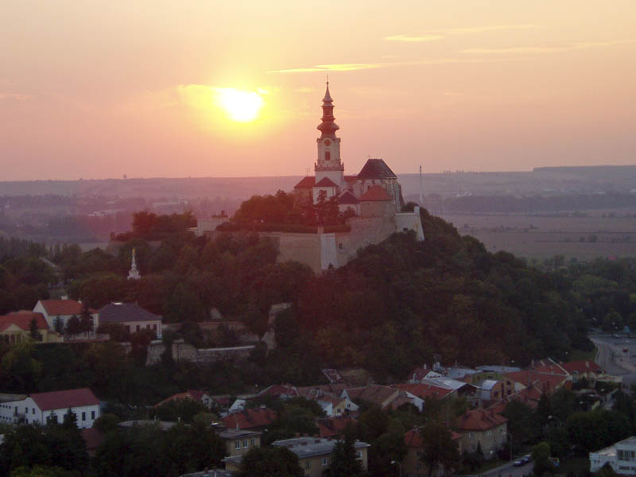
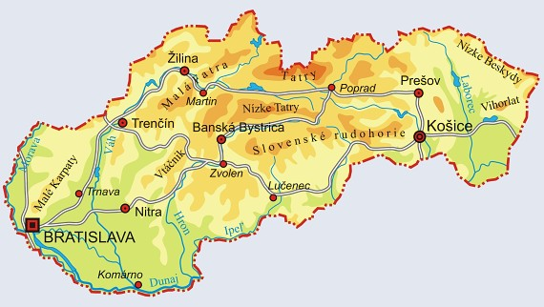
The climate of Nitra
Nitra lies in the north temperate zone and has a continental climate with four distinct seasons. It is characterized by a significant variation between hot summers and cold, snowy winters. The city is located in the warmest and driest part of Slovakia.

Slide 5
Past

Slide 6
Meteorology in the past
In the past, people didn’t have any equipment for forecasting the weather. They were observing the changes of the nature (wind, temperature, rain, animals...) and created weather lores based on these facts. Although Aristotle (350 BC) is considered the founder of meteorology the first instruments and classification scales were invented in 15th century.

Slide 7
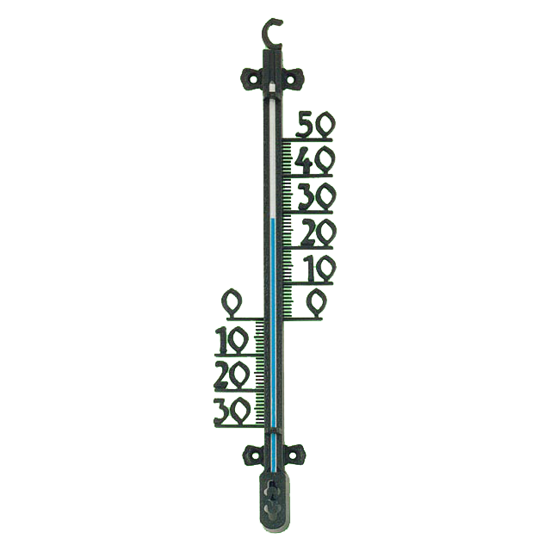
Records of
temperature
Spring: 11.4.2009 – 24,9°C
1971 – 24,5°C
Summer: 18.7.2007 – 38,5°C
1983 – 37,6°C
Autumn: 8.11.2010 – 21,3°C
1963 – 20,6°C
Winter: 16.1.2007 – 14,7°C
1983 – 14,1°C

Slide 8
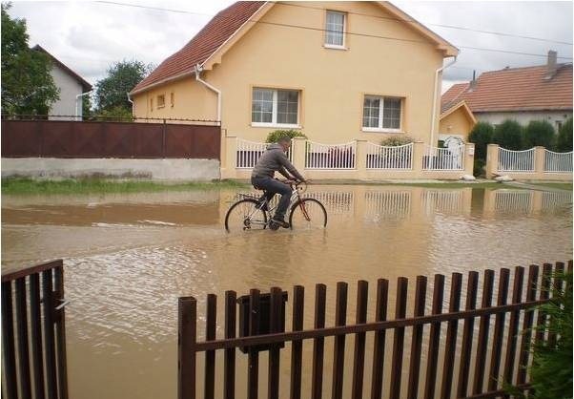
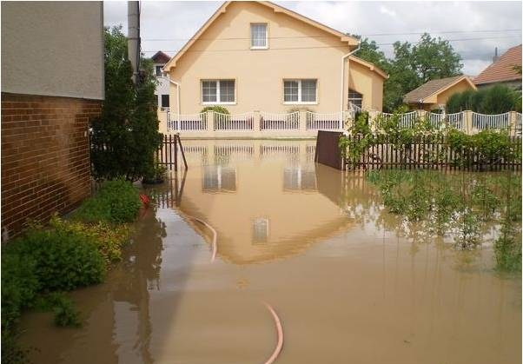
Floods
Weather sometimes makes us happy but sometimes not. When it rains a lot there can be floods. There were huge floods near Nitra the last autumn. Ten people died and hundreds of families lost their homes.

Slide 9
Present

Slide 10
Meteorological station ....
A weather station is a facility with instruments and equipment to make observations of atmospheric conditions in order to provide information to make weather forecasts and to study the weather and climate. The measurements taken include temperature, barometric pressure, humidity, wind speed, wind direction, and precipitation amounts. Manual observations are taken at least once daily, while automated observations are taken at least once an hour.
... in Janíkovce
was founded in 1982
airport meteorological station
the most windy of the lowland stations in Slovakia
uses traditional and automatic meteorological machines

Slide 11
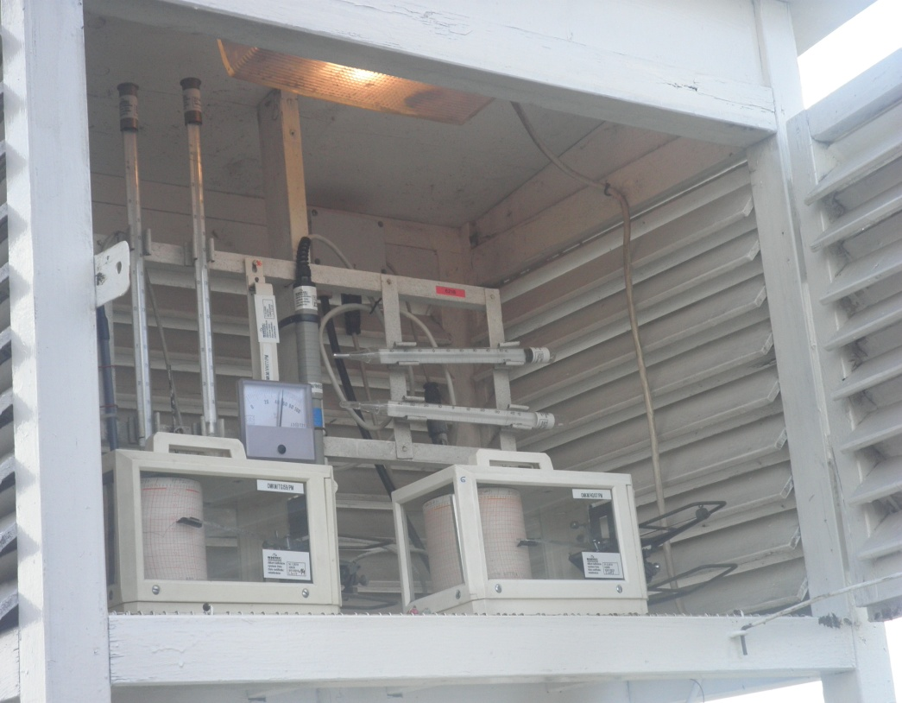
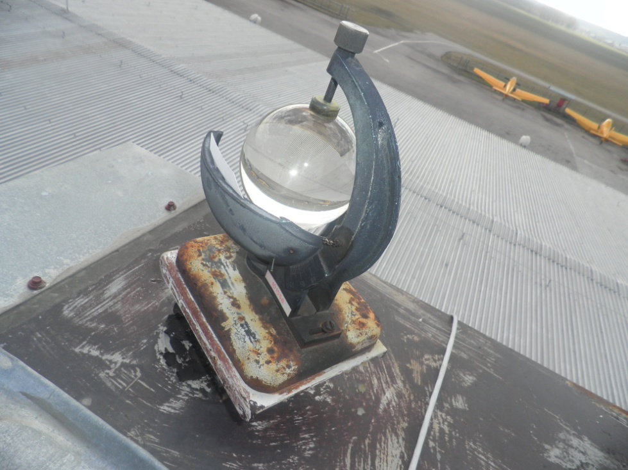
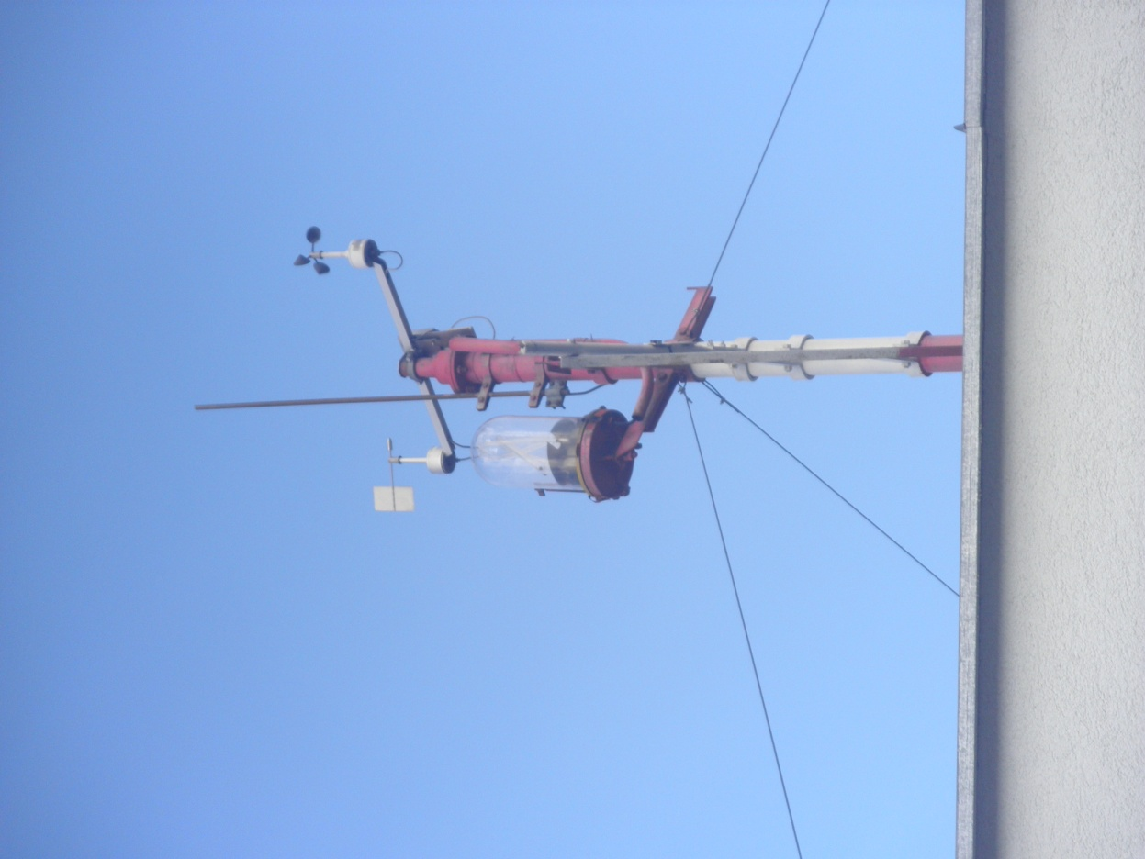
Equipment
Traditional instruments
Heliograph is used for measuring the lenght of sun shine.
Anemometer measures the strength and the direction of the wind.

Slide 12
Interesting figures
Average sun shine is 2200 hours per year.
Average temperature in summer is 21°C.
Average temperature in winter is -3°C.
Average precipitation is 550 mm per year.
The highest snow level was 34 cm.

Slide 13
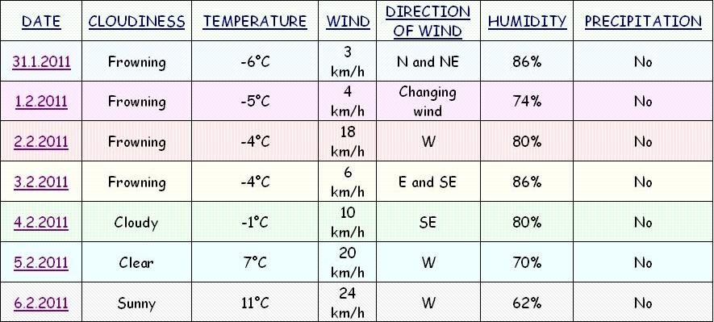
Our measurements

Slide 14
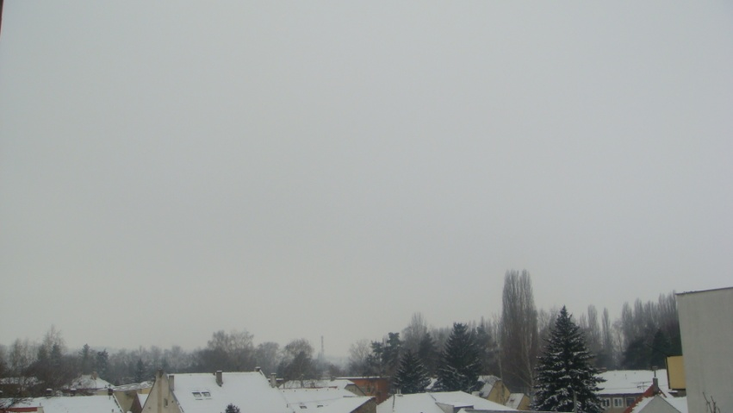
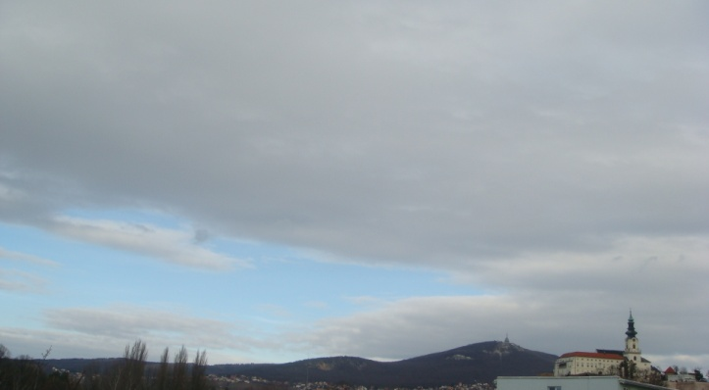
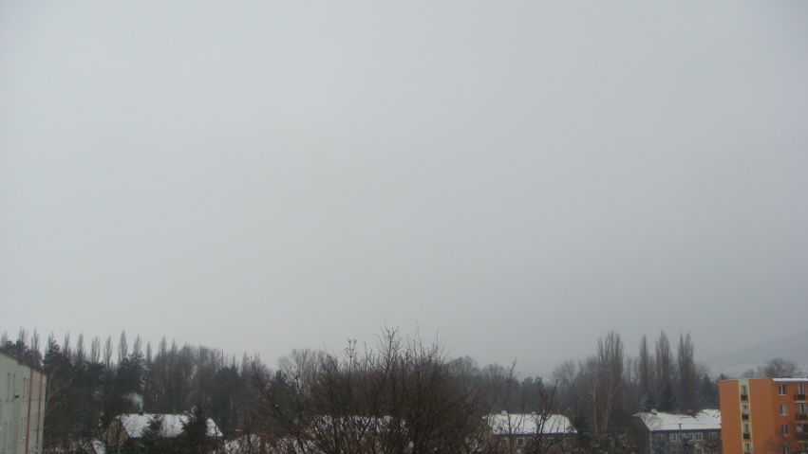
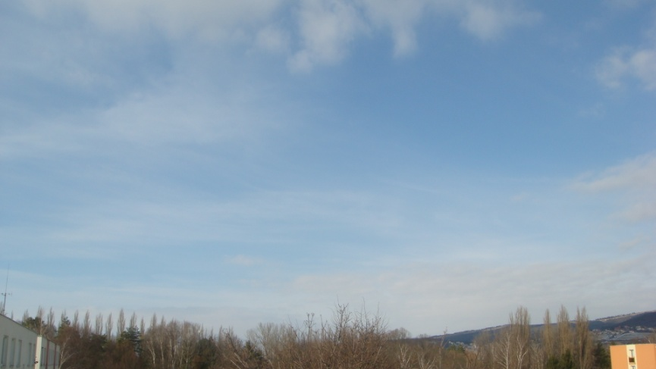
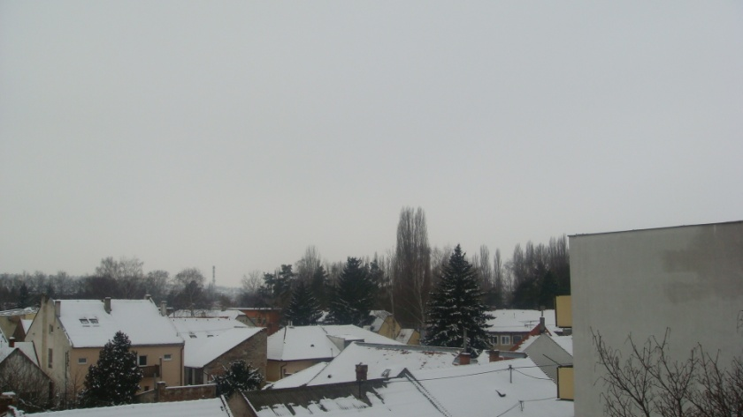
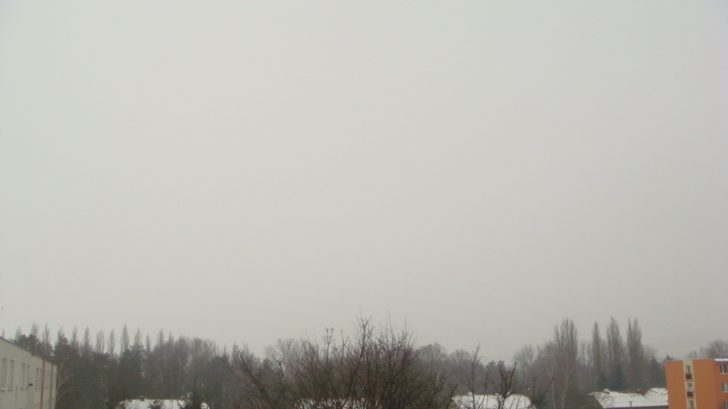
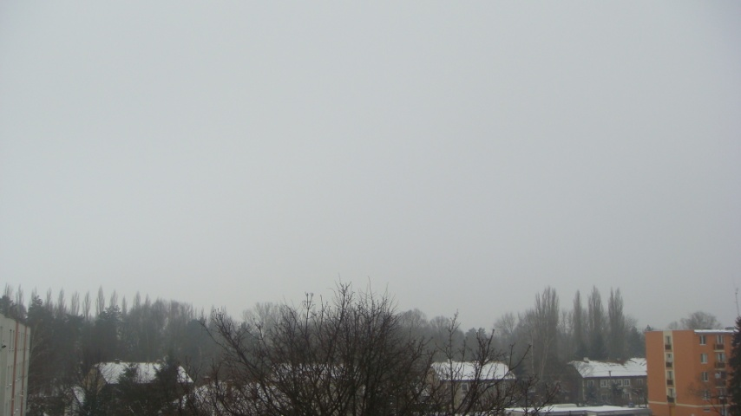
P
H
O
T
O
S
Monday
31.1.
Sunday
6.2.
Saturday
5.2.
Tuesday
1.2.
Wednesday
2.2.
Friday
4.2.
Thursday
3.2.

Slide 15
Questionnaire
What is your favourite season of the year?
Do you prefer snow or rain?
Do you like the climate in Nitra?
Are you meteosensitive?
How often do you watch weather forecast?
Do you rely on the weather forecast?

Slide 16
What is your favourite season of the year?
15%

Slide 17
Do you prefer snow or rain?
25%
RAIN
75%
SNOW

Slide 18
Do you like the climate in Nitra?

Slide 19
Are you meteosensitive?

Slide 20
How often do you watch weather forecast?
15%
Always
Do you rely on the weather forecast?
16%
Never

Slide 21
Future

Slide 22
Global warming in Nitra
During our research we have found out that the weather has changed a lot in the last ten years.
The average temperature is now 3°C higher than before.
Rains are heavier and floods are not so rare.
Wind is stronger and causes damage to forests.
All these facts are also influenced by our behaviour to nature. If we want to save our environment, we have to be more ecological.

Slide 23
Poem
The sun is shinning in the sky,
never mind that it`s so high.
If I were a bird I might fly,
rainy days still make me cry.
I just prefer pretty weather,
windy weather is not better,
sun-bath is my only pleasure.

Slide 24
Thank you!

