Slide 1
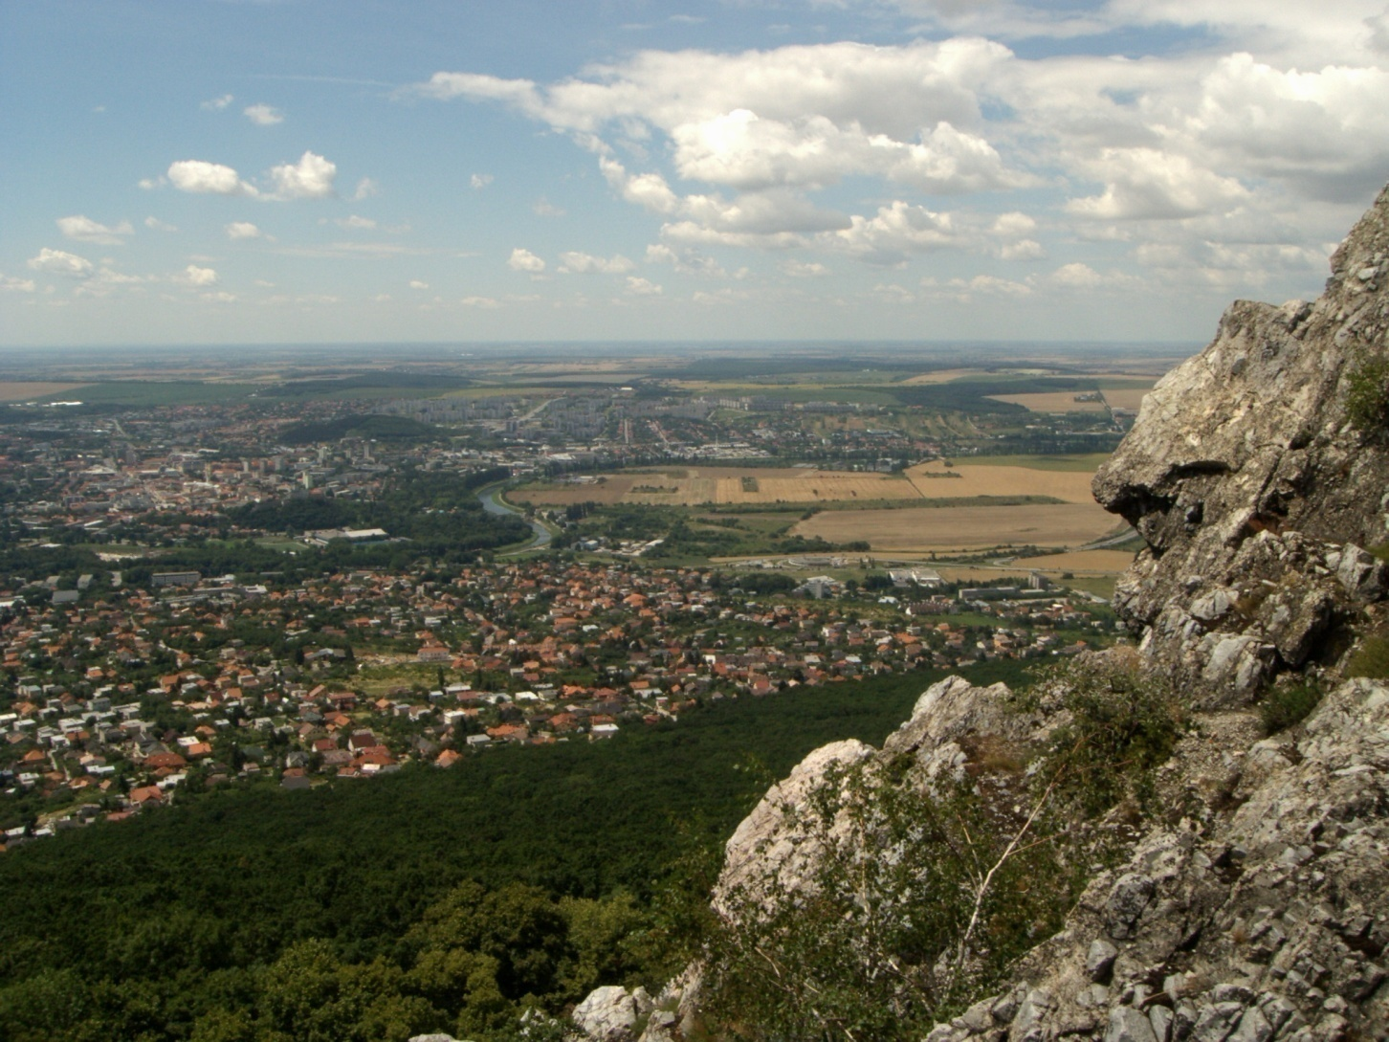
Home town - Nitra
Home town - Nitra
PaedDr Viera Juríková

Slide 2
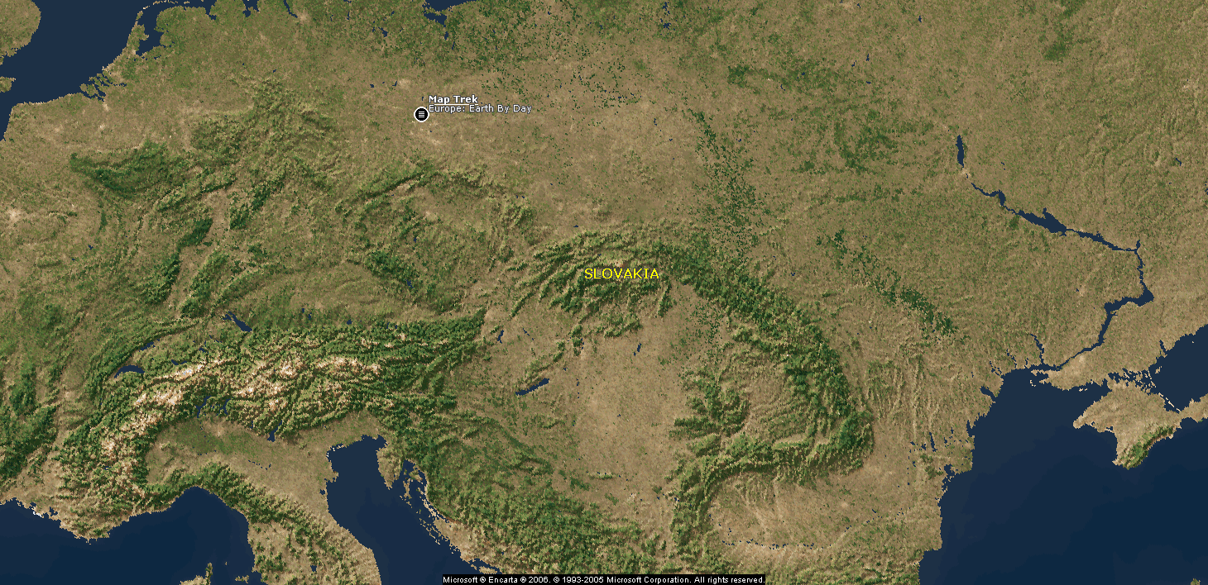

Slide 3
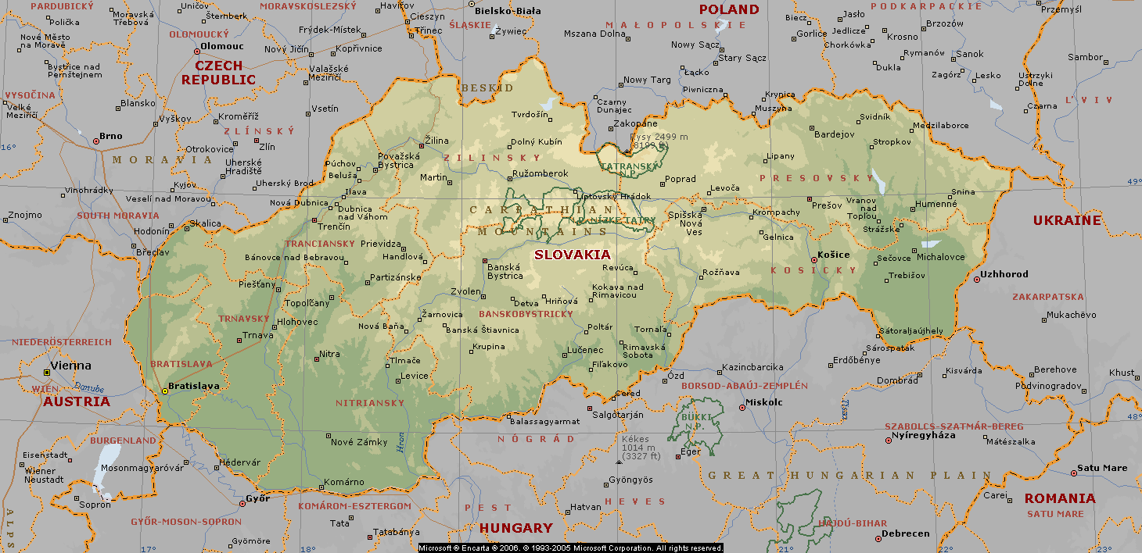
Nitra lies on the north-eastern part of Podunajská Lowland at the foot of Tribeč moutain range.
Location:48⁰18´ of north latitude and 18⁰14´of east longitude.

Slide 4
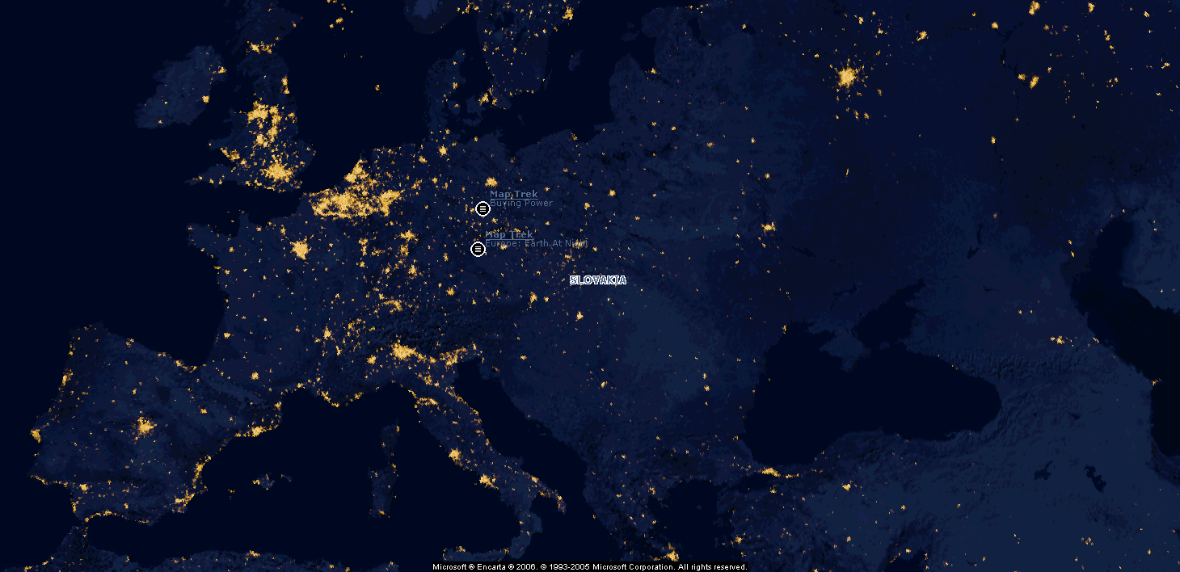

Slide 5
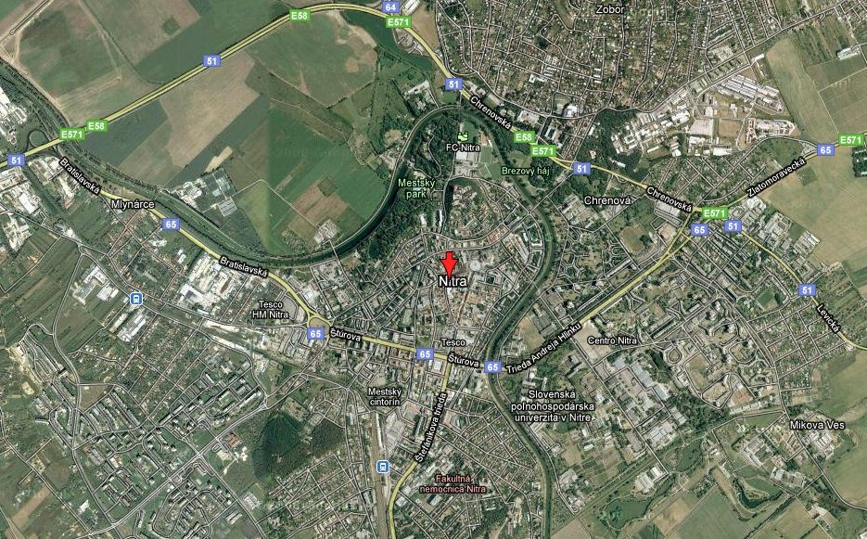
The map of a town and its surroundings.

Slide 6
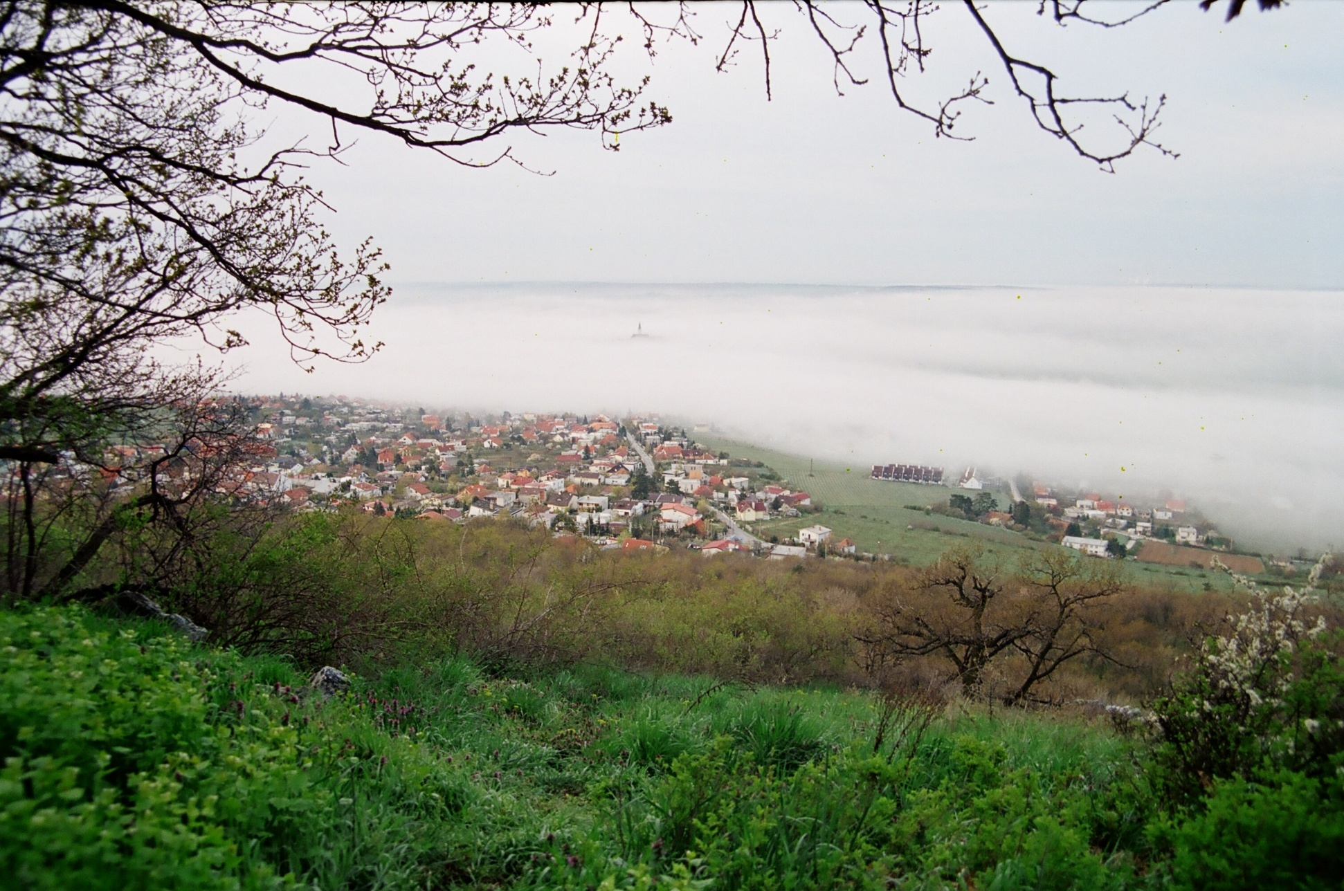
Welcome to the city in the heart of Europe.

Slide 7
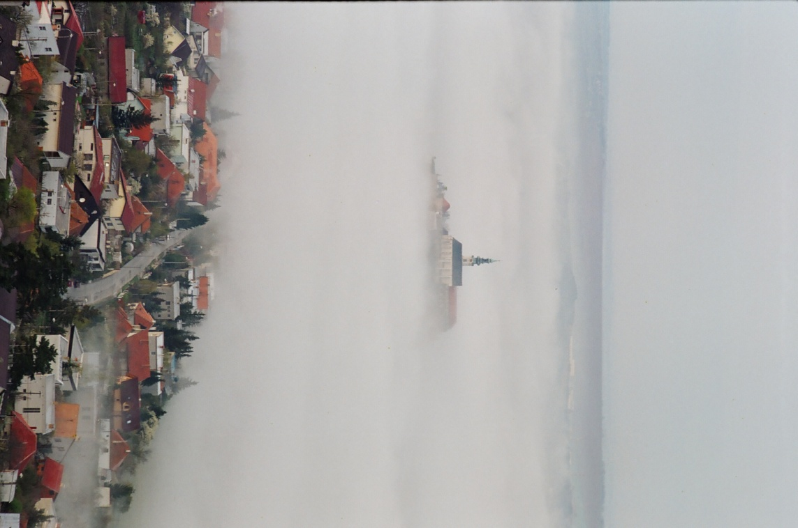
Nitra is a city in western Slovakia, situated at the foot of Zobor Mountain in the valley of the river Nitra. With a population of 85,000, it is the fourth largest city in Slovakia.
Nitra is also one of the oldest cities in Slovakia and the country's earliest political and cultural center. Today, it is a seat of a Nitra Region and a Nitra District.
Origin of the name
The first mention of Nitra dates back to 880 (other variations: 826 as Nitrawa, 880 as Nitra, and in 1111/1113 as Nitra, Nitria).
The name of the city is derived from the nearby river, which name is originated from the Germanic word Nitrahwa. In the indoeuropean languages Nid means flows while ahwa means water.

Slide 8
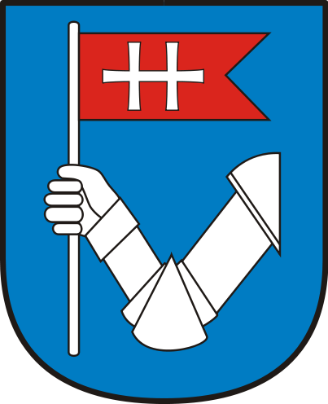
The coat of arm of Nitra.
In a blue shield a silver steel arm holds a red swallow tail flag with a silver horizontal double cross.
A document from the year 1461, representing an armoured-clad arm, carrying a flag with double cross, is the oldest evidence of a town seal.
Nitra coat of arms is a royal flag and was taken from the royal coat of arms from the 13-th century. At that time, the double cross was used without the triple hill.
It symbolises the granting of town privileges from the year 1248 when the town was ruled by Arpads dynasty.

Slide 9
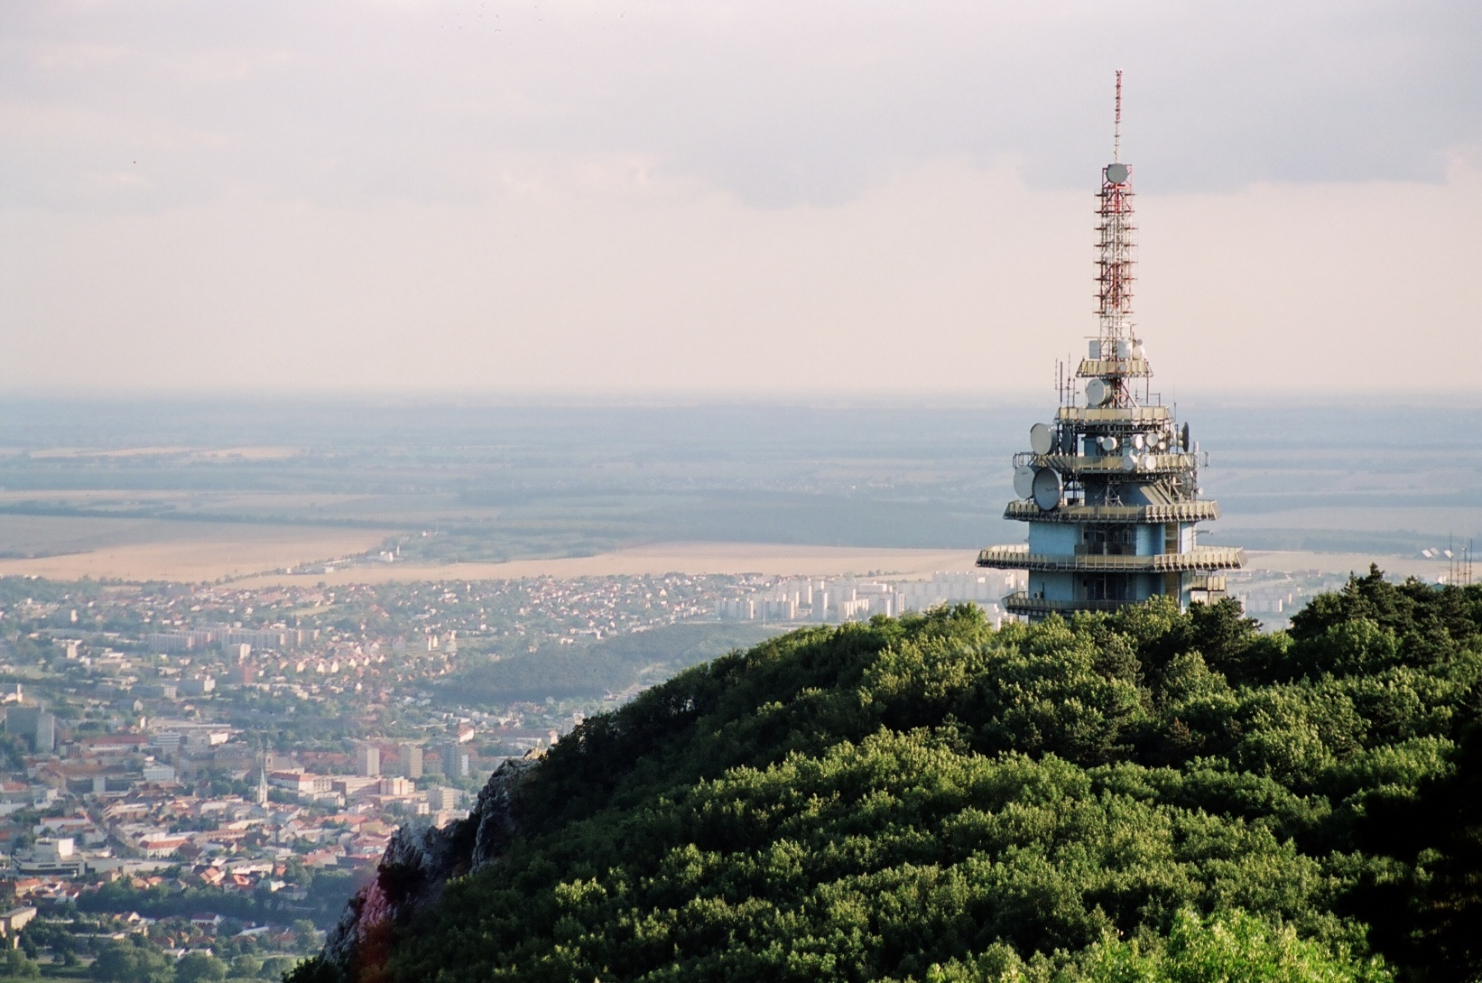
The view of the city from the pyramid.

Slide 10
Location
Nitra lies at an altitude of 190 metres (623 ft) above sea level and covers an area of 100.48 square kilometres (38.8 sq mil). It is located in the Nitra River valley in the Danubian Lowland, where the bigger part of the city is located.
A smaller part is located at the southernmost reaches of the Tribeč mountains, more precisely at the foothill of the Zobor mountain (587 m).
It is around half-way between Slovak capital Bratislava, 92 kilometres (57 mi) away and central Slovak city of Banská Bystrica, 118 kilometres (73 mi) away.
Other towns in the surroundings include Trnava to the west (53 km), Topoľčany to the north (35 km), Levice to the east (42 km), and Nové Zámky (37 km) and Komárno (71 km) to the south. A national natural reservation called Zoborská lesostep is located within the city's boundaries.

Slide 11
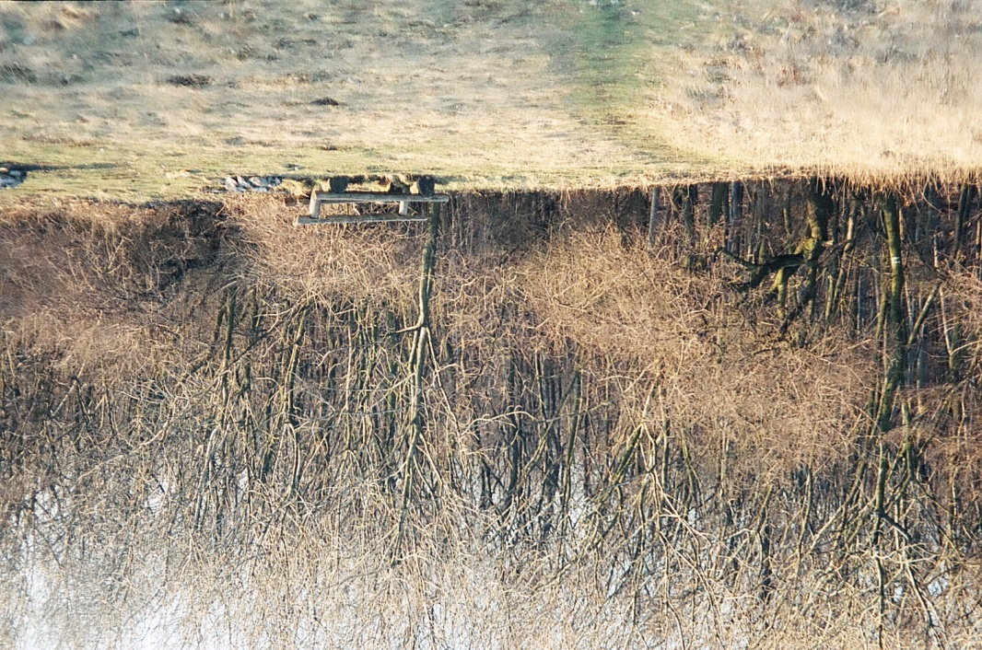
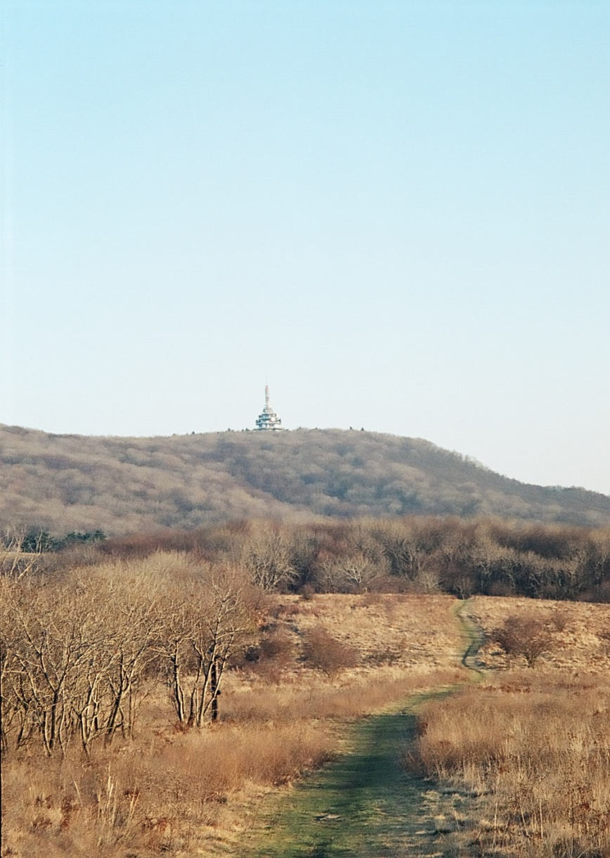
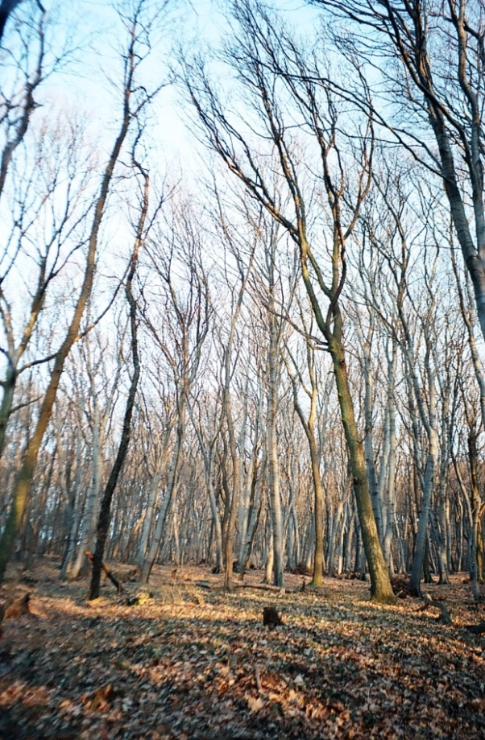
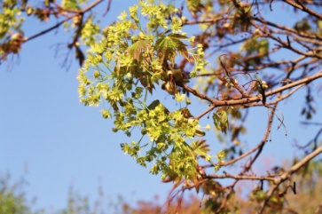
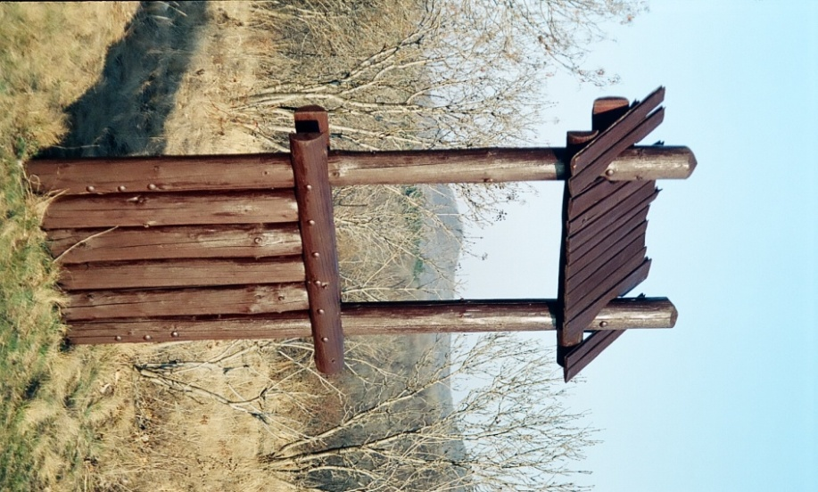
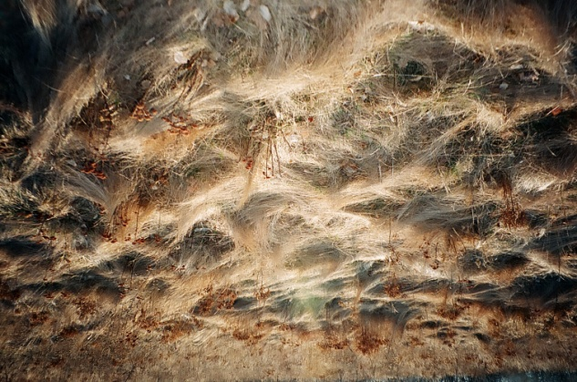
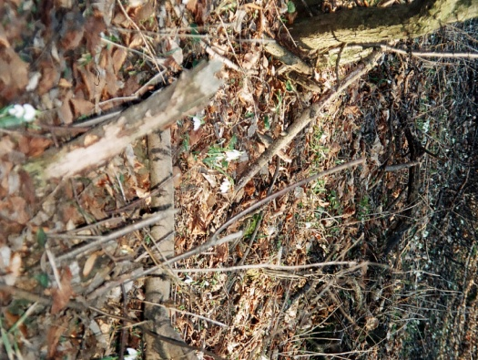
A national natural reservation called Zoborská lesostep.

Slide 12
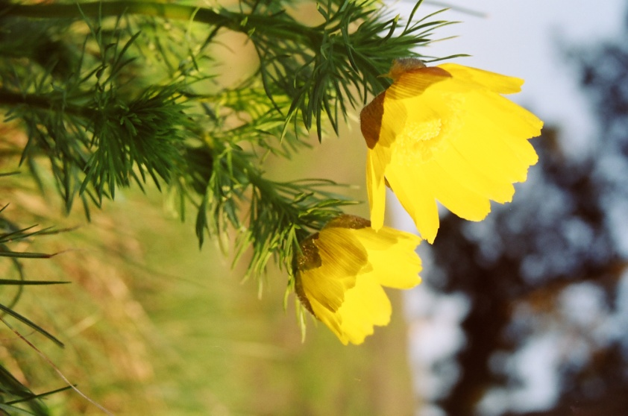
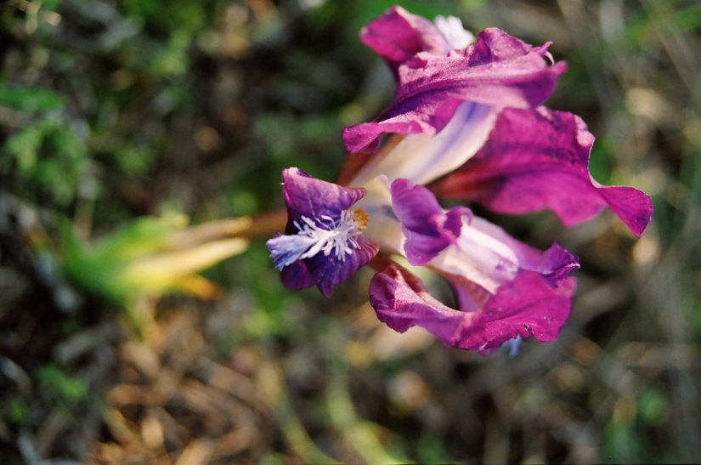
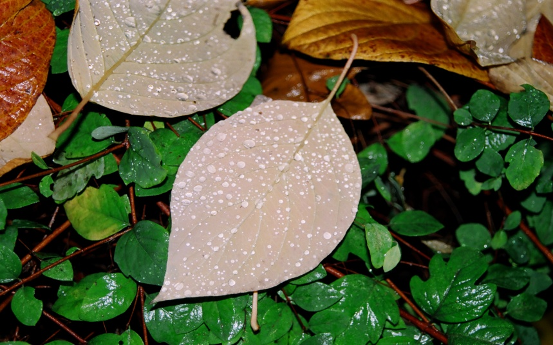
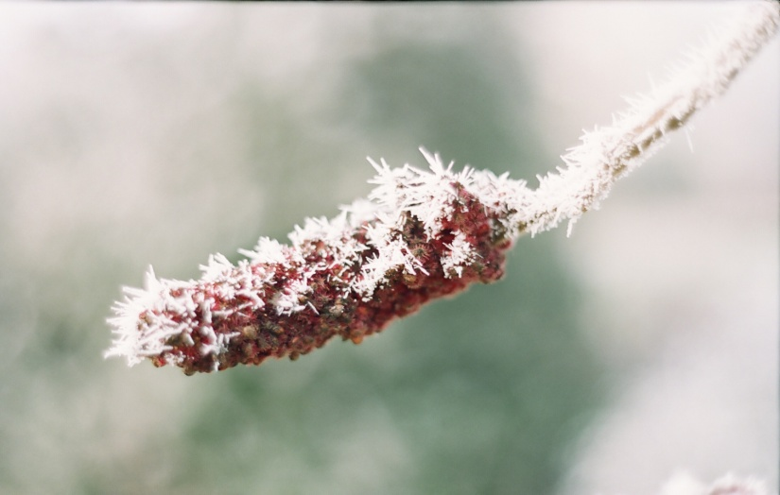
Climate
Nitra lies in the north temperate zone and has a continental climate with four distinct seasons.
It is characterized by a significant variation between hot summers and cold, snowy winters.
The city is located in the warmest and driest part of Slovakia.

Slide 13
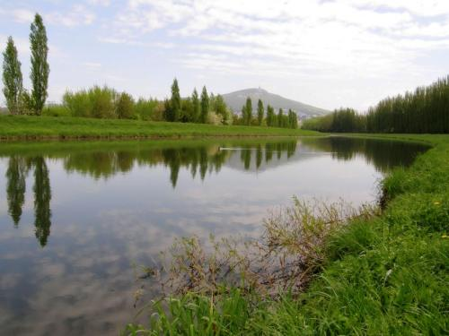
River Nitra

Slide 14
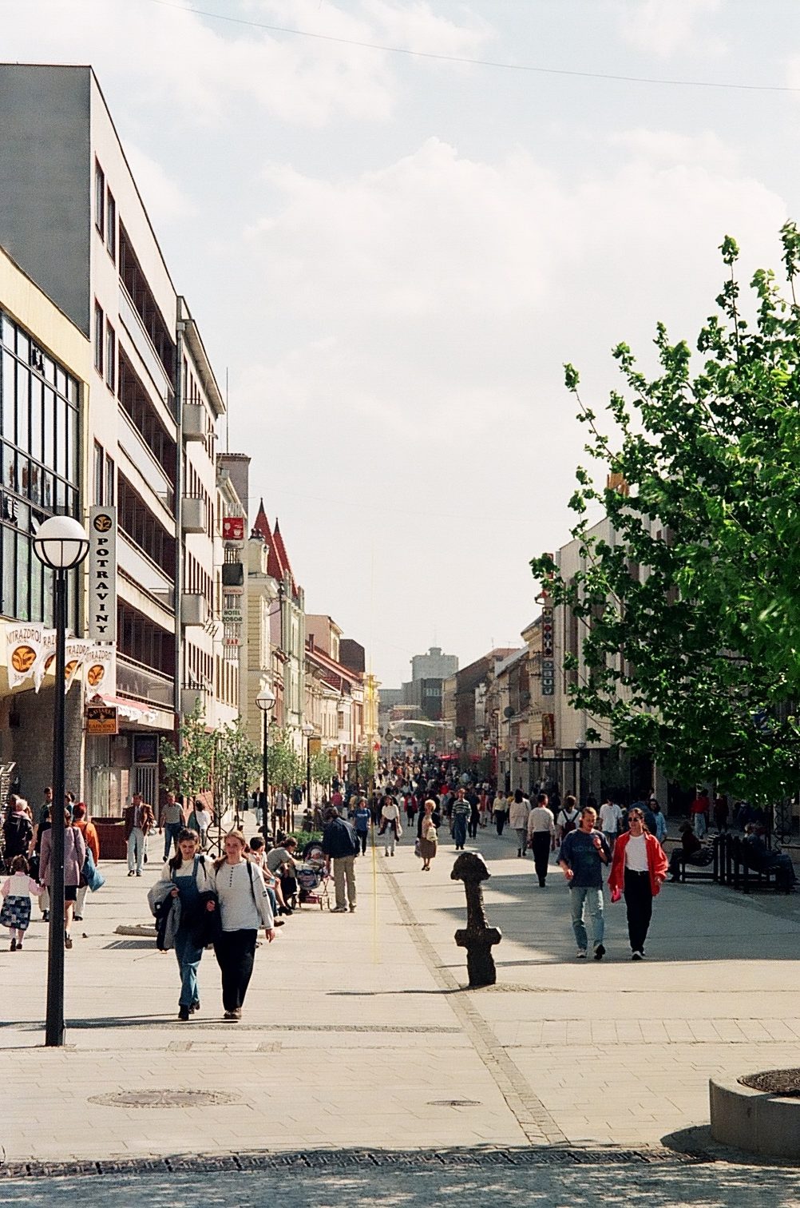
Population
Nitra has a population of 85,172 (as of December 31, 2005). According to the 2001 census, 95.4% of inhabitants were Slovaks, 1.7% Hungarians, 0.9% Czechs, and 0.4% Roma.
The religious make-up was 74.2% Roman Catholics, 17.2% people with no religious affiliation, and 2.8% Lutherans.

Slide 15
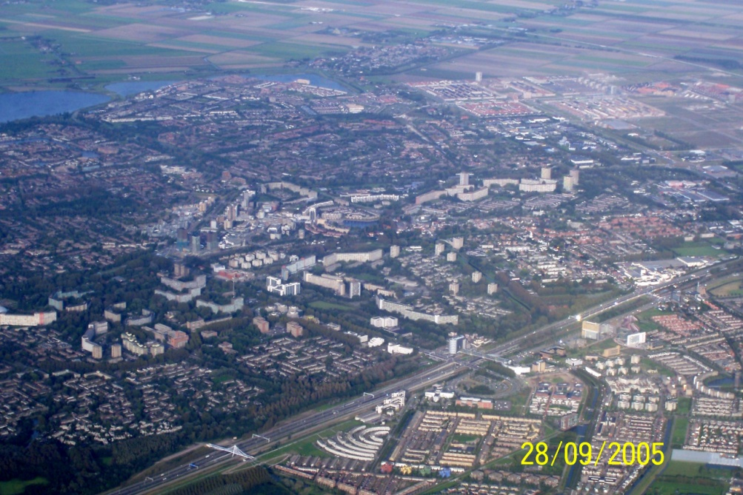
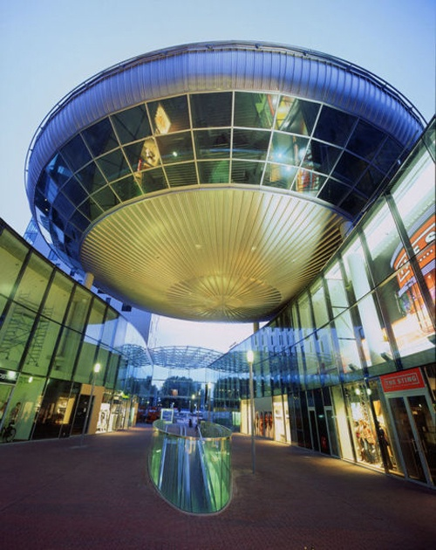
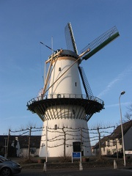
Twin Towns - Sister Cities
Nitra is twinned with:
Bački Petrovac in Serbia
České Budějovice in Czech Republic
Gosford in Australia
Guadalajara in Castile-La Mancha, Spain
Kielce in Poland
Kroměříž in Czech Republic
Naperville in United States
Osijek in Croatia
Spišská Nová Ves in Slovakia
Zielona Góra in Poland
Zoetermeer in Netherlands

Slide 16
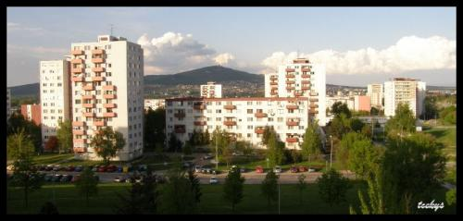
Nitra has several city districts administered and led by the chairperson; deputy of city council.
Town is devided into 13 districts (boroughs):
Old town, Mlynárce, Chrenová, Kynek, Upper and Lower Krškany, Štitáre, Janíkovce, Dražovce, Zobor, Párovské háje, Čermáň, Klokočina (which blocks of flats are in the picture), Diely.

Slide 17
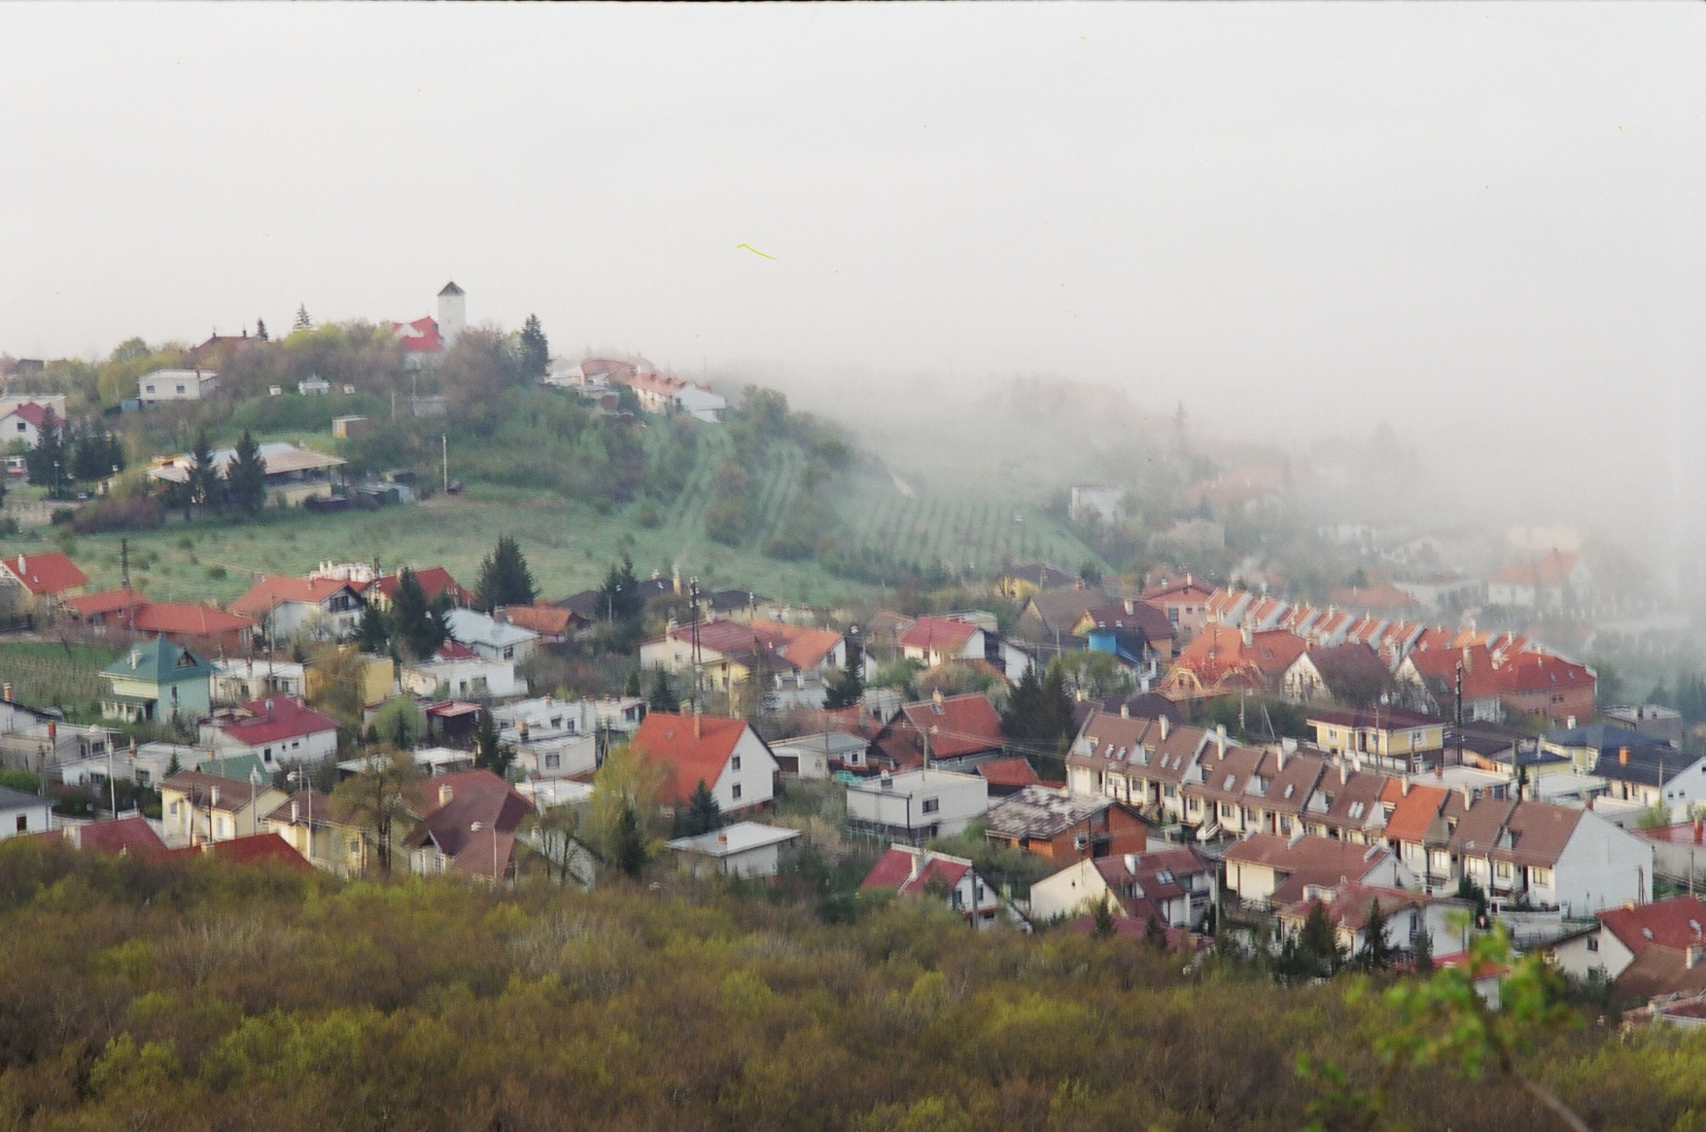
View of the detached and terrased houses in Zobor.

Slide 18
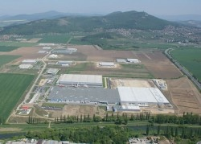
Economy
Nitra is the seat of the Nitra Region, which is an agricultural region. Food (brewery), mechanical and furniture industries are based in the city.
GDP per capita in 2001 was €3,643, which was below Slovakia's average (€4,400).
The city plans to have in 2008 a balanced budget of almost €34 million.
Industrial park in the south part of the town.

Slide 19
Government
The city is governed by a mayor and a city council .
The mayor is the head of the city and its chief executive. The term of office is for four years.
The current mayor, Jozef Dvonč, won the municipal election in 2006 and is supported by these political parties: Smer-SD, KDH, SNS, SF and HZD.
The city council is the legislative body, with 31 councillors.

Slide 20
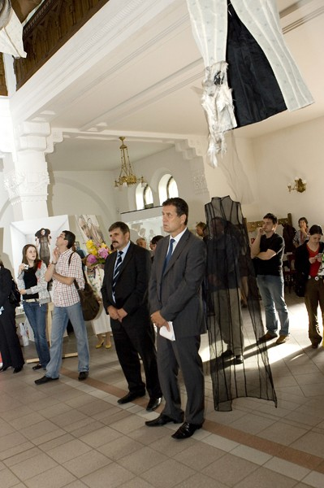
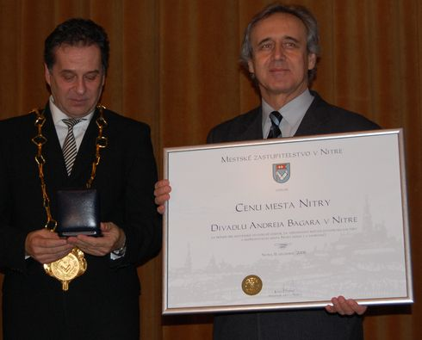
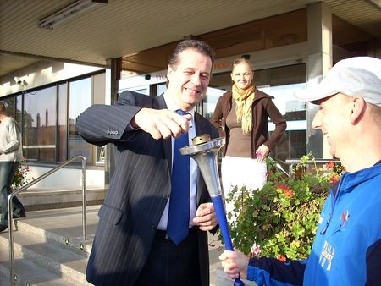


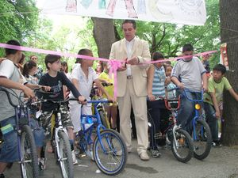
The current mayor, Jozef Dvonč.

Slide 21
Education
The city's system of primary education consists of 14 public schools and three religious primary schools, enrolling in overall 6,945 pupils.
Secondary education is represented by five gymnasia with 3,349 students,8 specialized high schools with 3,641 students, and 5 vocational schools with 3,054 students.
Nitra is the seat of two universities:
University of Constantinus the Philosopher, with 13,684 students, including 446 doctoral students and of the Slovak University of Agriculture, with 10,297 students, including 430 doctoral students.

Slide 22
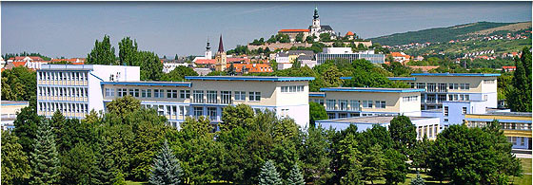
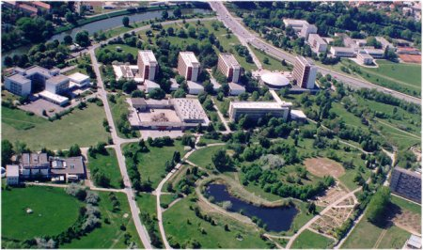
University of Constantinus the Philosopher
Slovak University of Agriculture

Slide 23
Transport
Nitra is connected to Trnava and Bratislava by a fast expressway (E58). There are also first-class road connections to Topoľčany, Zlaté Moravce (labelled as "Highway of Death"),Vráble and Nové Zámky. A planned bypass in direction to Banská Bystrica is planned to be completed by 2010.
The railway track from Nové Zámky/Šurany to Prievidza crosses the city, but it isn't one of the main tracks. There is a junction bit north of the town, connecting it with Leopoldov, Topoľčany and Radošina. Nitra has its own recreational airfield however the closest international airport is the Bratislava Airport.
Local public transport is based on buses with 30 lines, covering the whole city, as well as extending to the neighbouring municipalities of Lužianky, Nitrianske Hrnčiarovce, Štitáre, Ivanka pri Nitre and Branč (as of March 2008). There was a chairlift leading to Zobor hill, however, it has been closed since 1994.

Slide 24
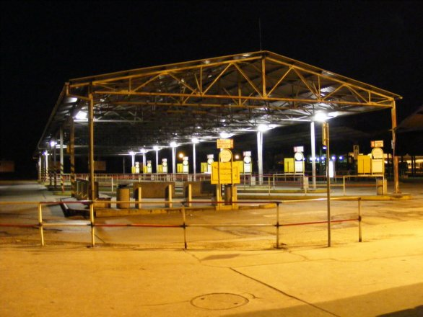
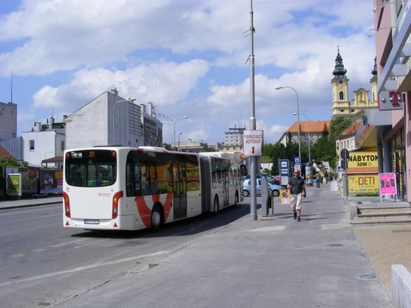


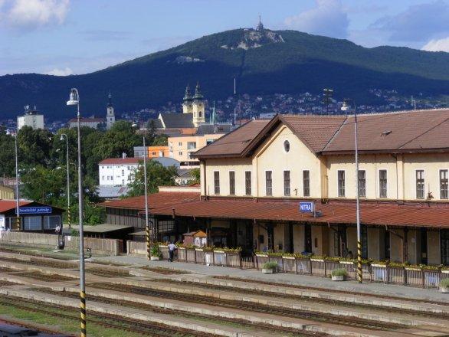
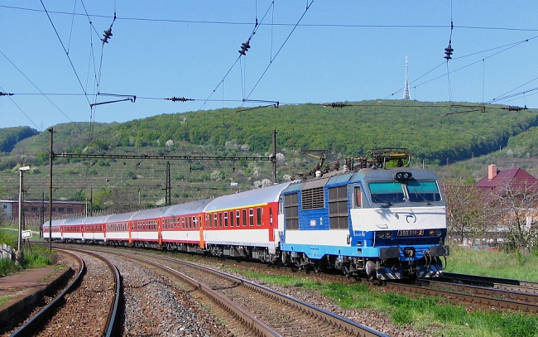
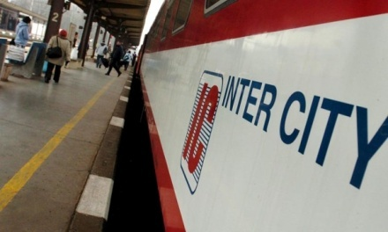
Public transport.
Many people travel by bus, most of inhabitants of our city drive their own cars. There are a bus station and a railway station in Nitra. There are
no trams or trolley buses but there are a lot of taxi-cars.

Slide 25
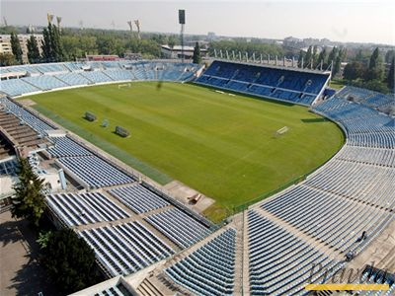
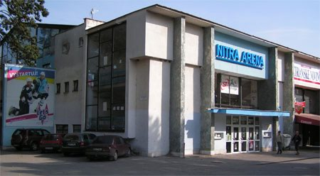
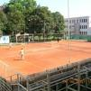
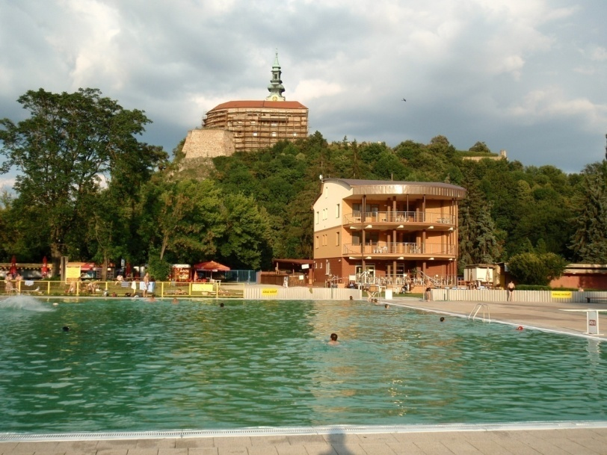
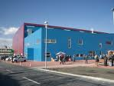
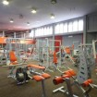
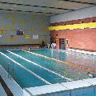
Sport.
Sport has a long tradition in our town. Sport lovers can spend their free time in many sport facilities - a football stadium, an ice rink, the tennis courts, the swimming pools, an athletic stadium, the sports halls for indoor sports, the fitness centres etc.

Slide 26
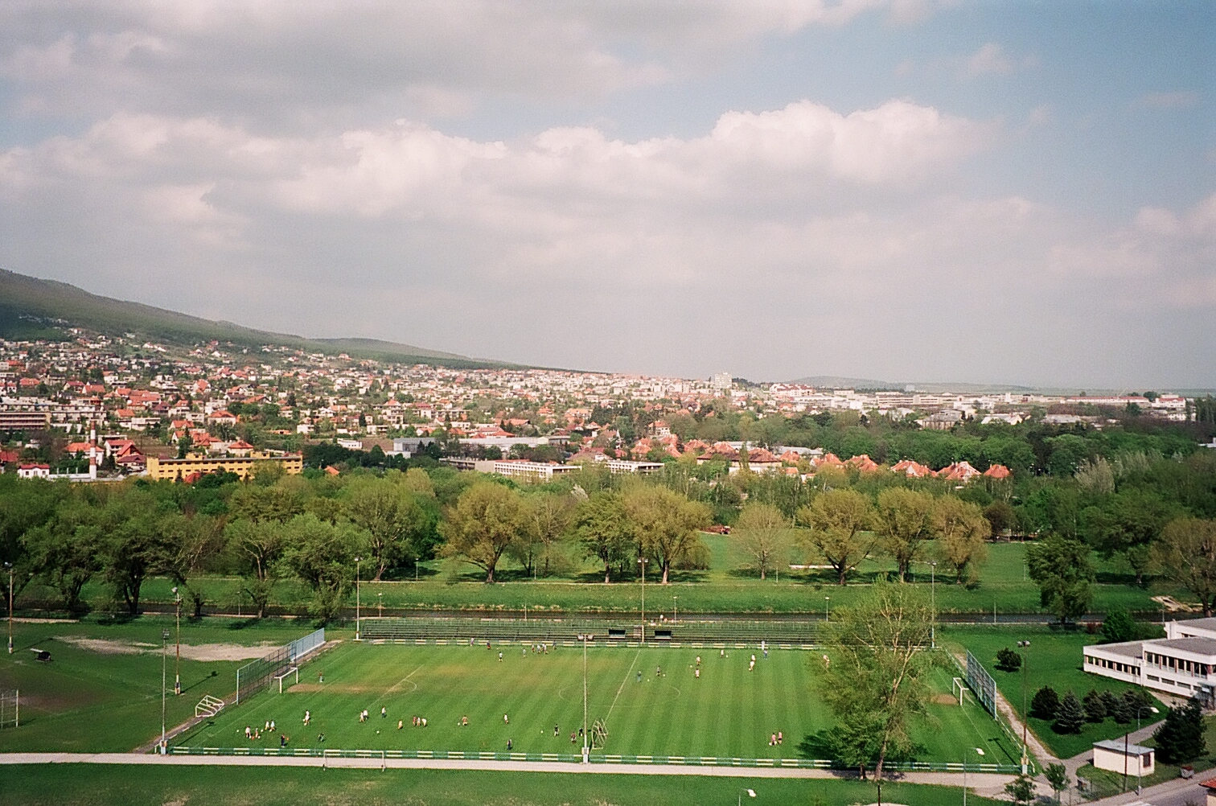

Slide 27
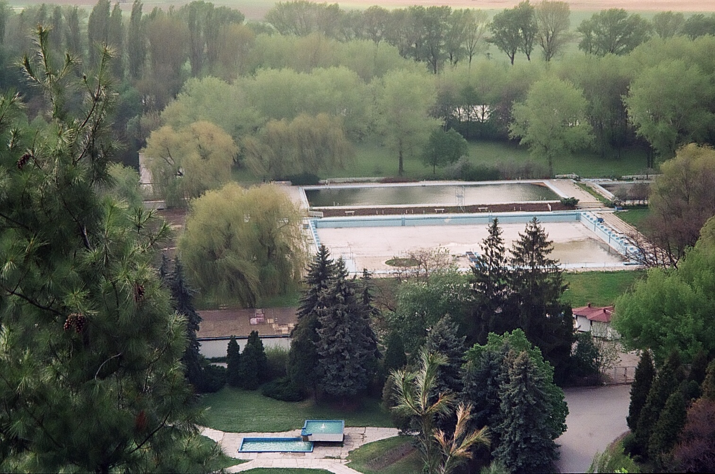
The view of the swimming pool from the castle.

Slide 28
History 1
The beginnings of its settlement go back as far as the earliest times, as has been documented by numerous archeological findings on the town's territory.
This area was a densely populated region some 30 000 years ago.
The first peasant settlements were on the territory of the town some 6 000 years ago.

Slide 29
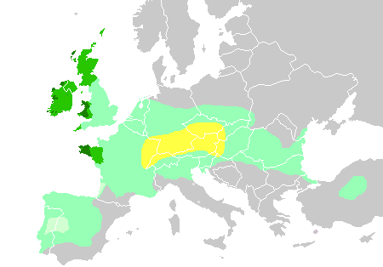
Inhabited for 6,000 years, Nitra has been a city of extraordinary historic importance.
A large Celtic settlement was founded in the 4th century BCE in the locality Martinský vrch.

Slide 30
History 2
In the fourth century B.C. the territory of Slovakia was inhabited by the Celts who remained here for a long period of time. They were skillful smelters and smiths whose huts and workshops were found at the foot of Martin hill..
Even the Dacians left some traces behind here.
The Slavic history of Nitra started near the end of the 5th century when the first Slavs arrived here. As early as the first half of the 7th century, some western sources mention a state formation of Slavs, the Samo Empire.
The Samo Empire was a predecessor of the subsequent state formation - the Great Moravian Empire, one of whose centres was Nitra. Precisely during the time of the Great Moravian Empire, the foundations of the renowened fame of ancient Christian Nitra were laid, as was recorded in extremely precious documents from the 9th century.

Slide 31
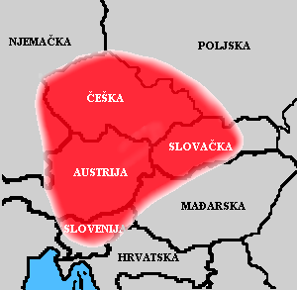

Samo (died 658) was a Frankisch merchant from the "Senonian country" (Senonago), probably modern Sens, France. He was the first ruler of the Slavs (623–658) whose name is known, and established one of the earliest Slav states, a supra-tribal union usually called (King) Samo's empire, realm, kingdom, or tribal union.

Slide 32

Pribina square

Slide 33

The statue of an Atlant supporting the sky, nicknamed „Corgoň“ by citizens, at the corner of the Kluch palace.

Slide 34

History 3
One of these fortified settlements may have been the residence of Prince Pribina under whose rule Nitra was an important political, military and economic centre. Pribina showed great wisdom as a statesman and had great insight into European politics, when in about 828 A.D.,he, being a heathen himself, allowed the first Christian church in Nitra to be consecrated. This act was performed by Adalram, the Archbishop of Salzburg.
The Pribina church is the first historically documented witness to the Christianity of the Slavs on the territory of Slovakia. This great events is mentioned in a document "Conversione Bagoariorum et Carantanorum" dating back to 870-871.
In its later development, the Nitra principality was forcibly annexed by Mojmir to the Moravian principality in about 833, and a new state entity was formed which is mentioned in sources under the name Great Moravia.

Slide 35

Solun brothers
After the dethronement of Mojmir, Rastislav became the ruler of Great Moravia. His reign is connected with a very important event, namely the comming of the Byzantine missionaries, Constantine-Cyril and Methodius, in 863.
Constantine-Cyril developed the first Slavic alphabet, which was called "glagolitic", he also translated the first liturgical texts into Old Slavonic. Methodius, whom Pope Hadrian II had authorized to be consecrated as a bishop in 870 and later as archbishop, was named as a papal legate for Pannonia and for the Upper Danubian Slavs.

Slide 36
History 4
Nitra was at the height of its fame during the reign of King Svatopluk .
In one of the most valuable written documents for Slovak history, in the letter from Pope John VIII to Svatopluk, dating back to 880, "Indistriae tuae", Svatopluk is addressed as king and the Pope informs him of the appointment of Viching as bishop of Nitra, by then, probably had a municipal character, and it consisted of five fortified settlements and twenty communities where skiled craftsmen plied their trade.
Until the beginnig of the 14th century Nitra remained the resedential town of the principality that bordered the newly formed Hungarian monarchy. Also, during the Middle Ages it was the site of important historical events, and it was often plundered by various armies.
The Benedictines took up the organization of ecclesiastical life, their monastery of St. Hyppolite on the slope of Zobor hill was the oldest in Slovakia.
In 1248 the ruler Bela IV, in appreciation for protection from the Tartars, promoted Nitra to the status of free-royal town with privileges similar to those of Székesfehérvár.

Slide 37

Svatopluk I with three twigs according legend of Svatopluk's twigs and his three sons Mojmír II, Svatopluk II and Predstav.

Slide 38

The scene from the performance about the king Svätopluk during a theatrical festival annually held in Nitra.

Slide 39

Svätopluk Square

Slide 40

Andrej Bagar theatre in Svätopluk Square.

Slide 41
History 5
The medieval Nitra was divided into the Upper Town and Lower Town, the latter being further divided into several separate parts, each with its own alderman and local seals. Four new independent parishes came into being in connection with the churches of St. Michael in the square Na vrsku, St. James in the central square, St.Stephen in Parovce, and Our Lady on the Calvary hill.
From the second half of the 18th century, Nitra escaped from military hardships, this made possible the renovation of the town and modifocations on the castle and especially on the Cathedral.
Peaceful times made the construction of several buildings in the Upper Town possible. As a result of the town's development, the population grew beyond 10 000, in the 19th century. In 1873 Nitra became the town with its municipality presided over by a mayor and by numerous public councilmen.
The further development of the town was strongly influenced by two World Wars.

Slide 42



Synagogue (below),
Piaristic church, Calvary

Slide 43
After World War I and disintegration of Austria-Hungary, the Czechoslovak Legions occupied the town since 10 December 1918 to secure the rule of newly established Czechoslovakia. Nitra continued to be the seat of the Nitra county, until it was dissolved in 1928. After break-up of Czechoslovakia in 1939, Nitra became a part of the First Slovak Republic and once again a seat of Nitra county until 1945.
The period of the First Slovak Republic was tragic for the numerous Jewish population of Nitra, which was first victimized by the anti-Jewish law and then mostly exterminated in German concentration camps. The rest of Jews fled the city and country.
The city was liberated by the Soviet Red Army in 1945, for only three years of restored democracy in Czechoslovakia. The Communist period from 1948 to 1989 was marked by oppression of Catholic church, which has traditionally strong presence in Nitra.
Catholic seminaries, monasteries and other properties were nationalized and converted to museums, schools and offices. This period experienced the extensive growth, building the housing projects and annexing of formerly independent villages.
After the Velvet Revolution of 1989 and dissolution of Czechoslovakia, Nitra became part of newly established Slovakia and became a seat of the Nitra Region in 1996.

Slide 44



Slide 45






Slide 46


Slide 47


Slide 48

The castle dominates the city.

Slide 49




City park

Slide 50

Lash green of spring.

Slide 51

The place to hide...

Slide 52

The water men.

Slide 53



Slide 54


Slide 55








Slide 56


Slide 57


Slide 58


Slide 59



Slide 60



Slide 61


Slide 62


Slide 63


Slide 64

Why not to explore Nitra yourself?

